Slide 1
ThinkPro

Slide 2
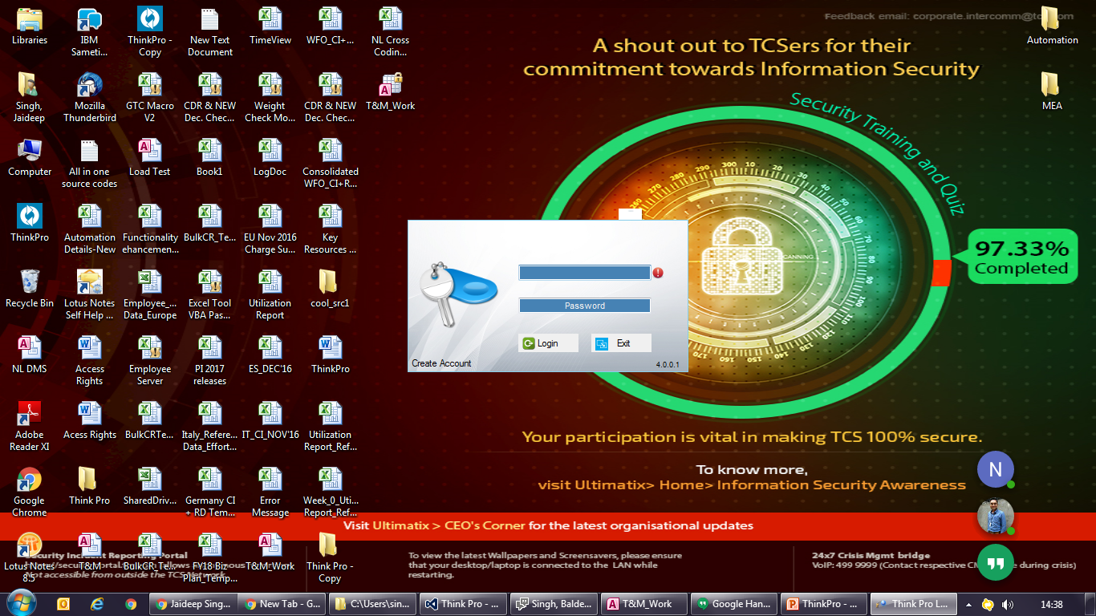
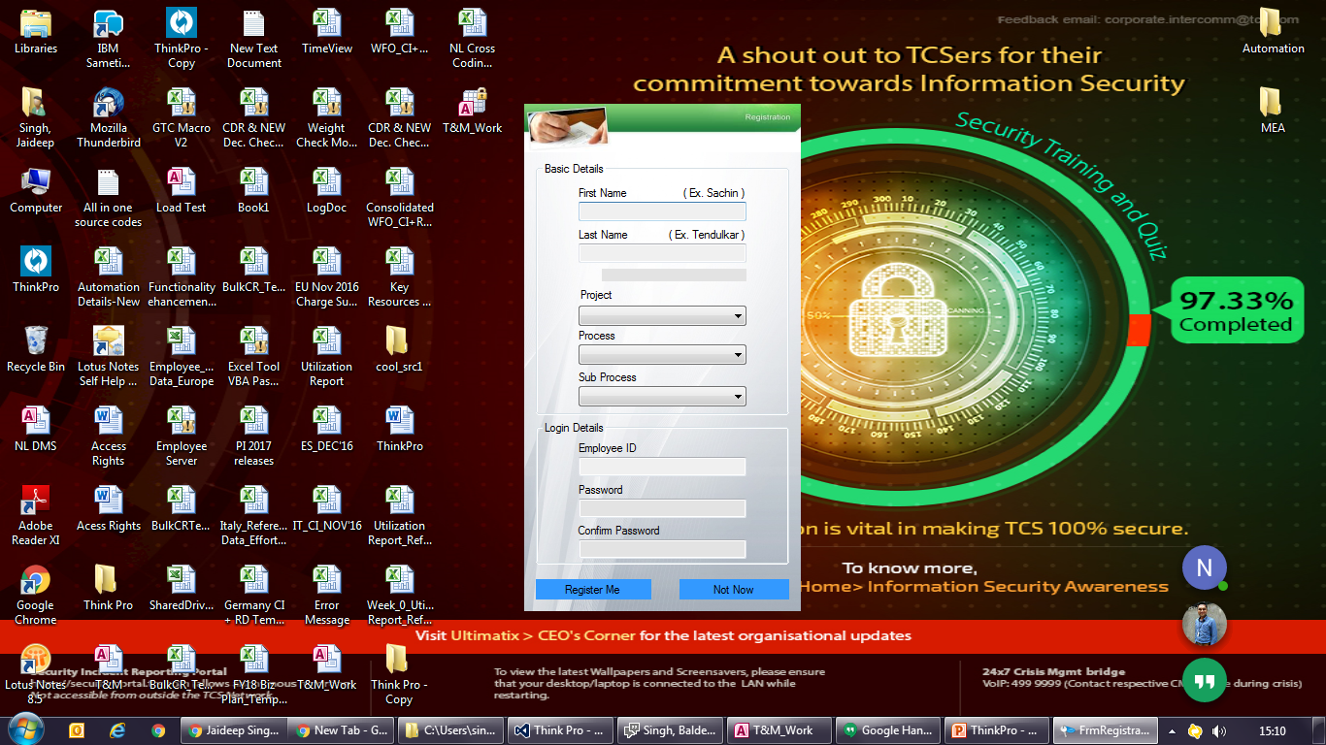
1- Registration & Login
1)LOGIN:- On Login Click it will search to master database of provided Empl-ID and Password,
if ID and Password found and matches the it will fetch user details like Project, Process,
Sub Process and Load Home Screen with details Else will show Error-
Function Login()
2)CREATE ACCOUNT:- It will first search weather the details is available or Not.
If not available then will add the records.
Function IDCheck()----It will check whether entered ID is available in database or not.
Function Registerme()---It will register the use and save entered records to the database.
3)REGISTRATION:- On Registration it will Create a default Profile with registered Process and Sub Process
Function DefaultProfileCreation()

Slide 3
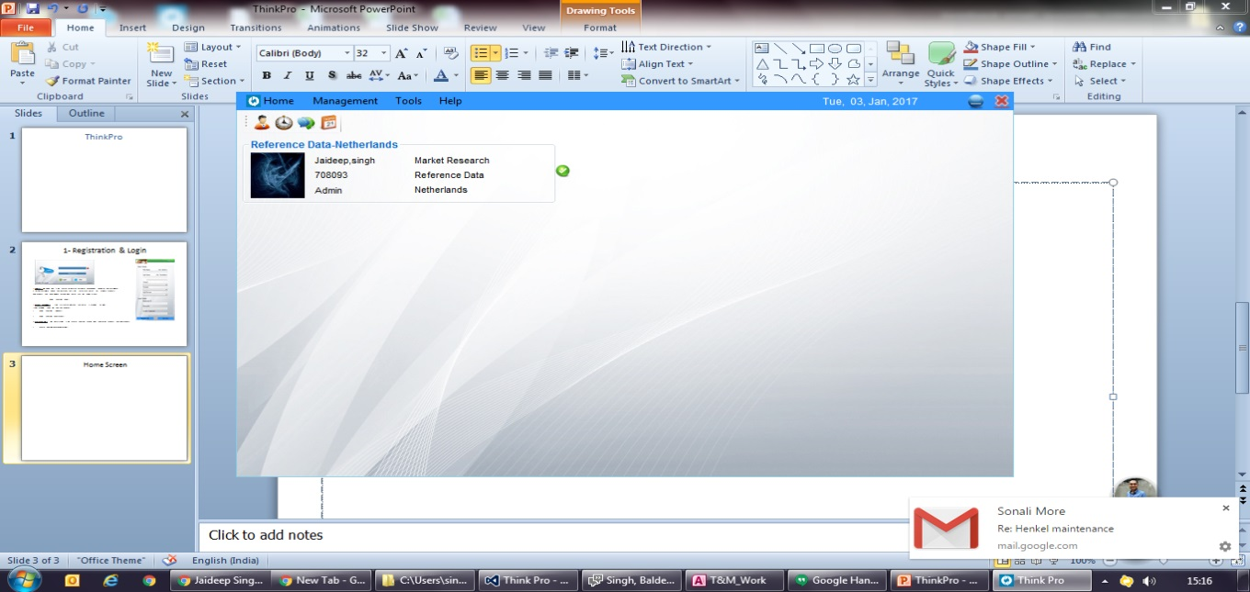
Home Screen
Home Screen Load
Events
1) LOAD TIMER
FillMyProfile()------It will Load Default user profile
ProfilepicLoad()----It will Load User Profile Pic
DBpath()------------It will Load Process Data base path
Login()-----------------will log login time.
AccountType()---------It will load account type access rights
AccessRightsCheck() ---IT will provide access rights as per account type
2) Msg Timer
UnreadMsg()------IT will fetch all the unread messages and show popup notification for unread message.
3) LockTimer.
It wil continuesly check for pc lock/unlock status
TimeView Management
My Profile
TimeView(T&M)
Leave Management

Slide 4
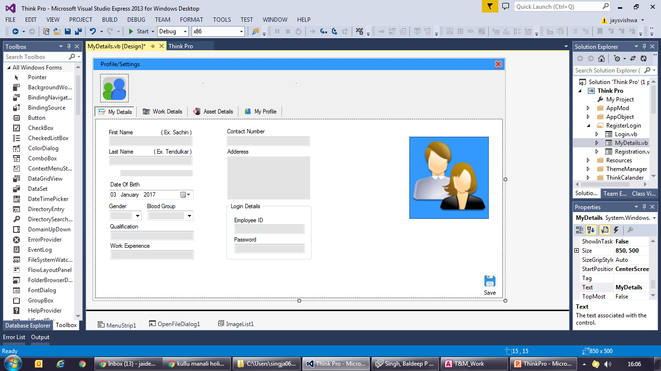
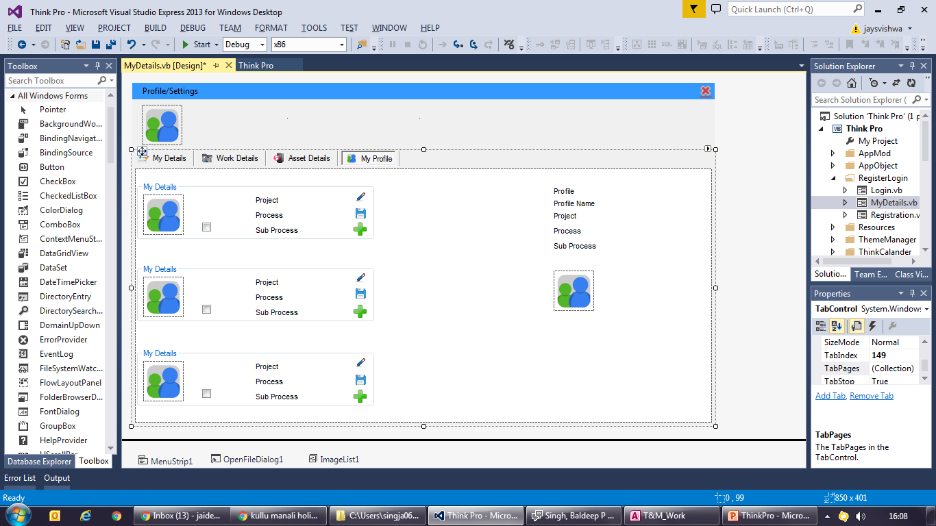
My Profile
Home
User needs to fill all the details related to process.
1) My Profile:- User can create up to 3 profile as depending upon cress process utilization .

Slide 5
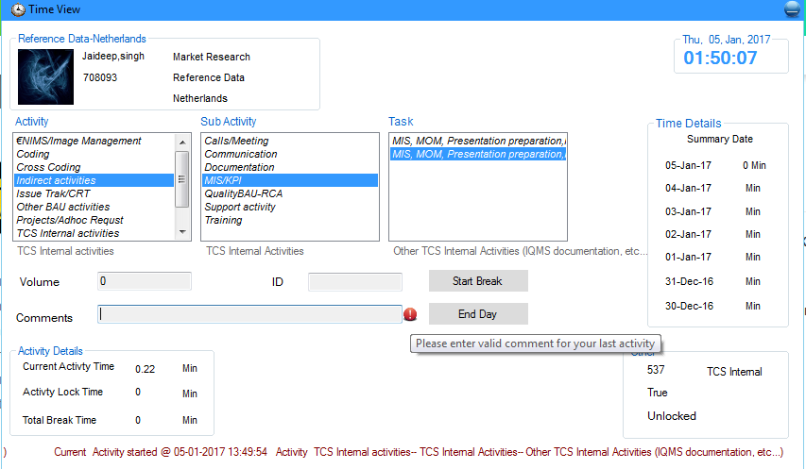
Time View
Home
User needs to select Activity, Sub Activity and Task as per requirement and double selected task to start activity time.
User can click on time details group to view /Edit previous 7 day activities, Item Count and comments.
Activity details group will display Current Activity time, PC Lock time in current activity, and Break timings.
Events
BreakTimer:- It will Log the time if Break is selected or PC is Locked.
TmrCurrentAct:- It will log time of current activity.
Functions
FillActivity()---------Load Activities on startup
GetProfilePic()------Load Profile Picture
TimeDetails() & TimeGroupFill()--------Load time details of last seven days I Time details Group box.
Activity Selection
Last seven days data, user can edit Activity(in case of wrong head was selected, can update item count and comments
Error msg. incase no comments for Indirect and TCS Internal activities
Volume or ID is mandatory in case of UPD is defined for activity
Current Activity Ticker

Slide 6
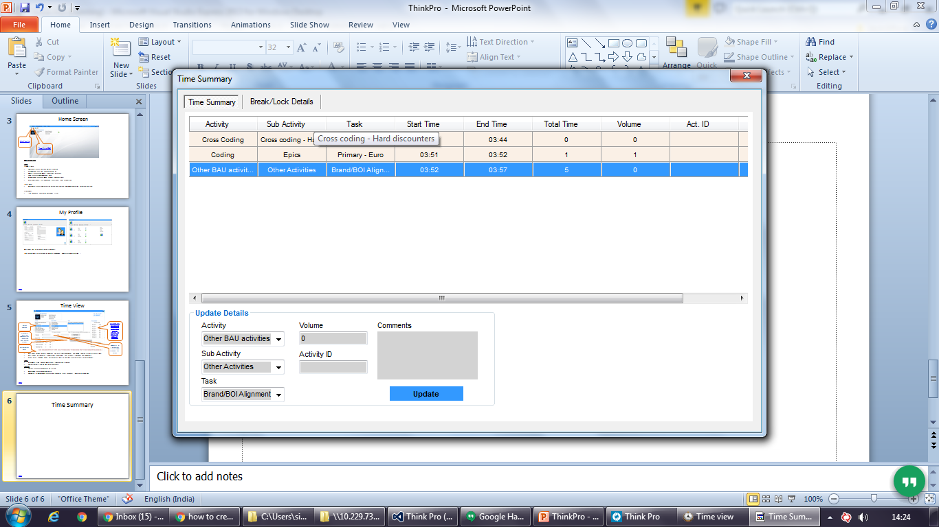
Time Summary
Home
Back
User Can Edit Activity, Volume, ActID., Comment in case of wrong activity head is selected.(Start time, End time and Total item is not editable).
Users can see their break details and PC lock Time during Activity.

Slide 7
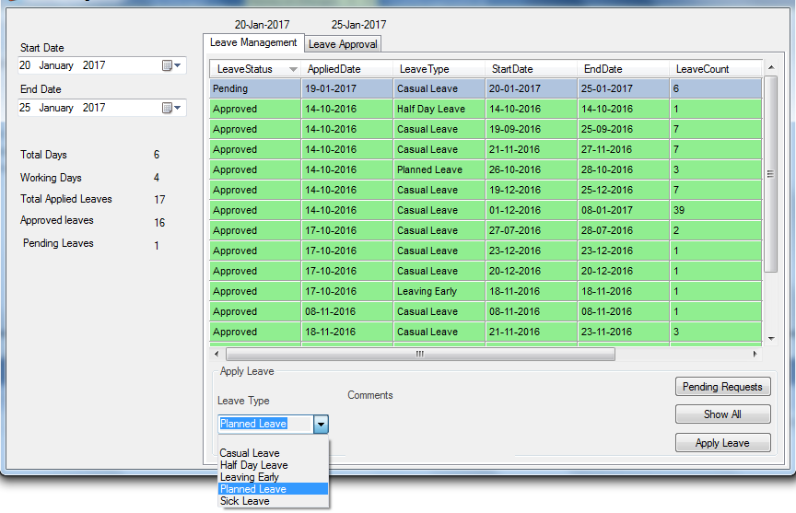
Leave Management-Apply Leave
Home
User Can Apply leave by selecting start date and end date, select Leave Type and apply leave.
User can see all the applied leave and Leaves pending for approval.
Select Start and End Date
Select Leave Type

Slide 8
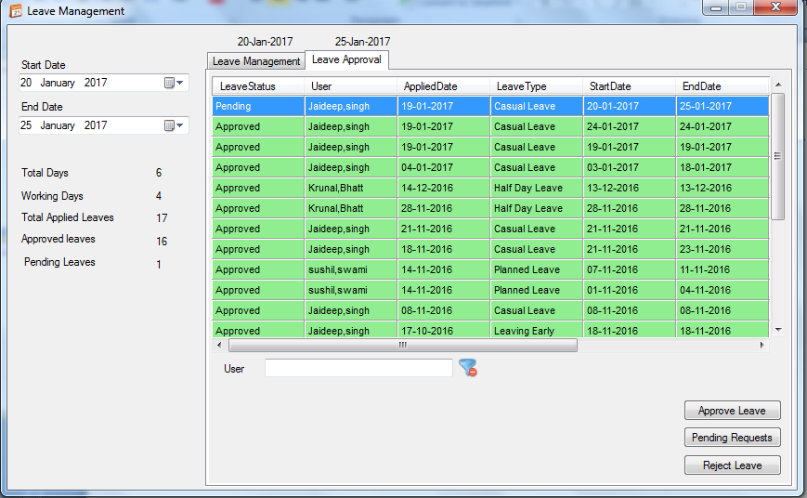
Leave Management-Leave Approval
Home
Supervisor can approve leave or reject leave
On approving leave the it will get added under leave head in timesheet.

Slide 9
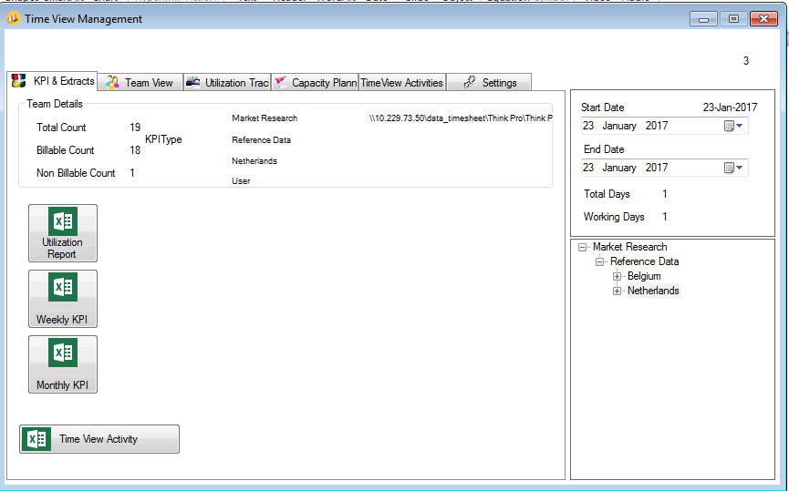
TimeView Management
Home
Select Date and Process to extract the KPI

Slide 10
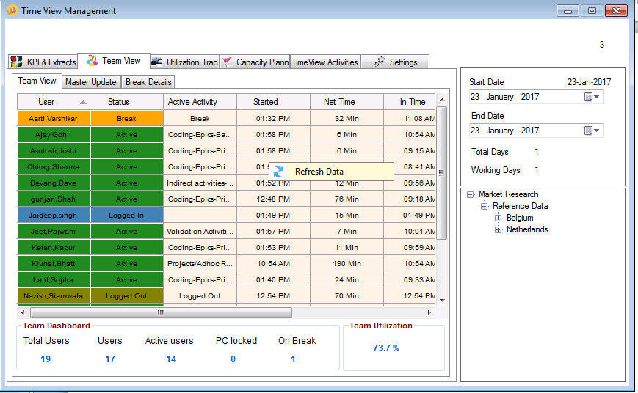
Team View
Home
Refresh Data to view team status
Able to view current team status i.e. Current activity, activity selected time, in and out time
Refresh Data to view team status

Slide 11
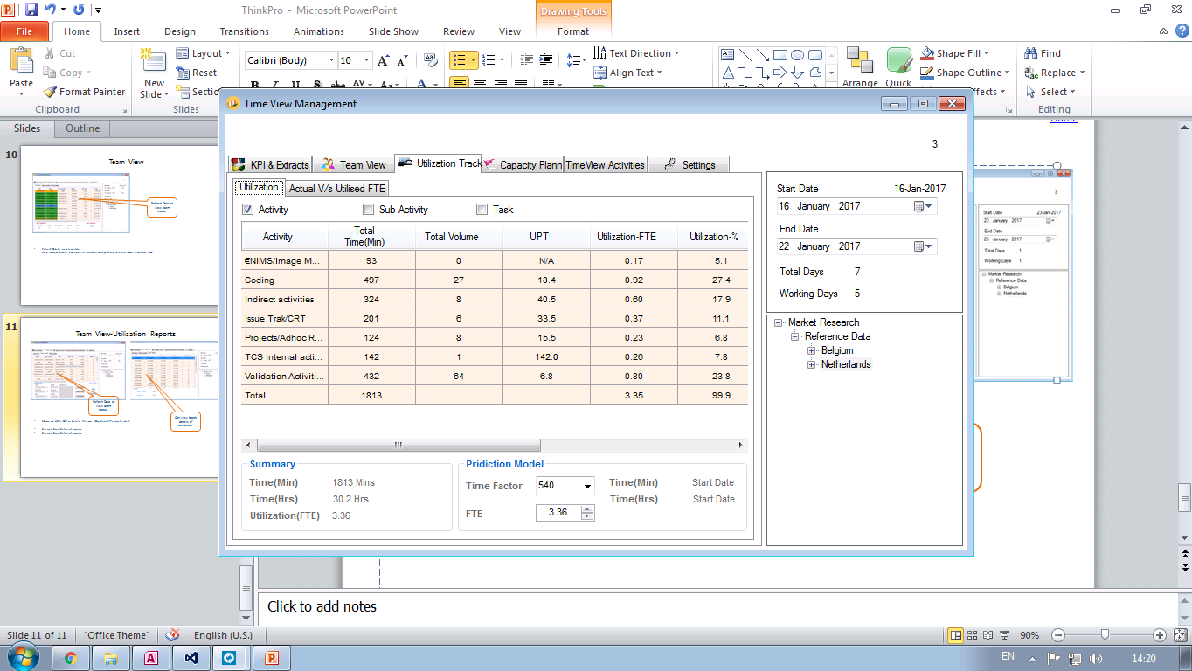
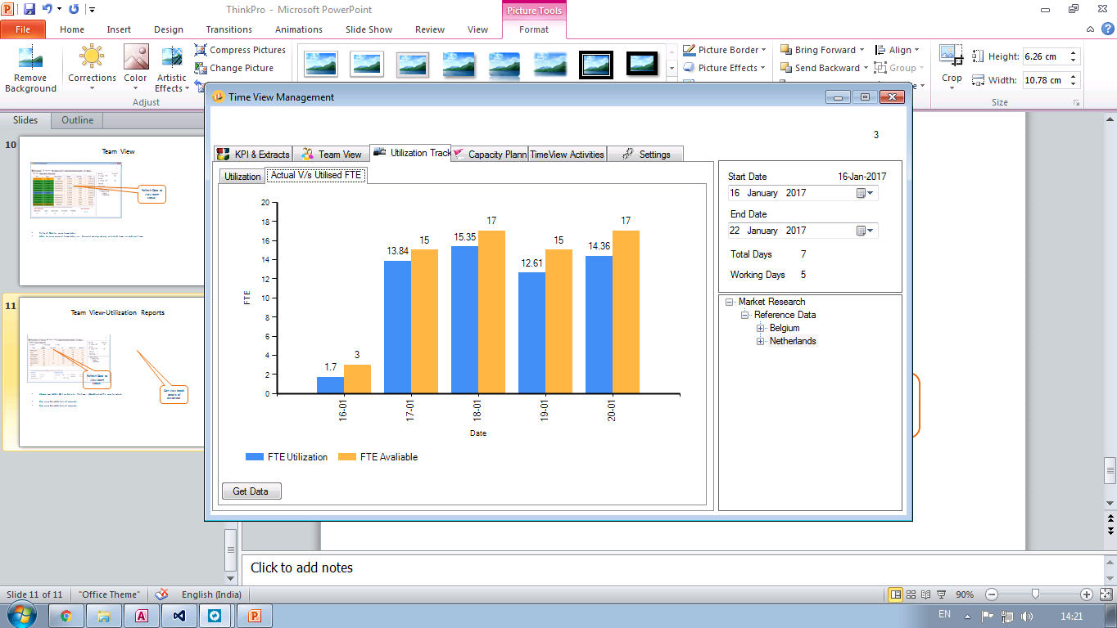
Utilization Reports
Home
Admin can view Utilization report Activity wise
Can view available FTE Vs Utilized FTE Date Wise
Utilization report Activity wise
Can view available FTE Vs Utilized FTE Date Wise

Slide 12
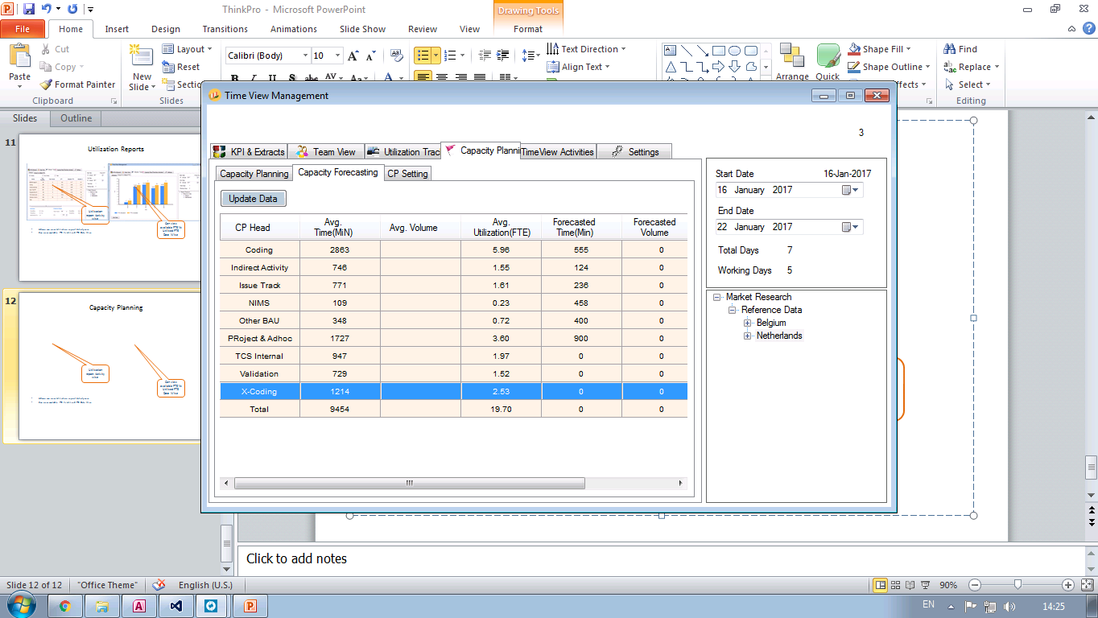
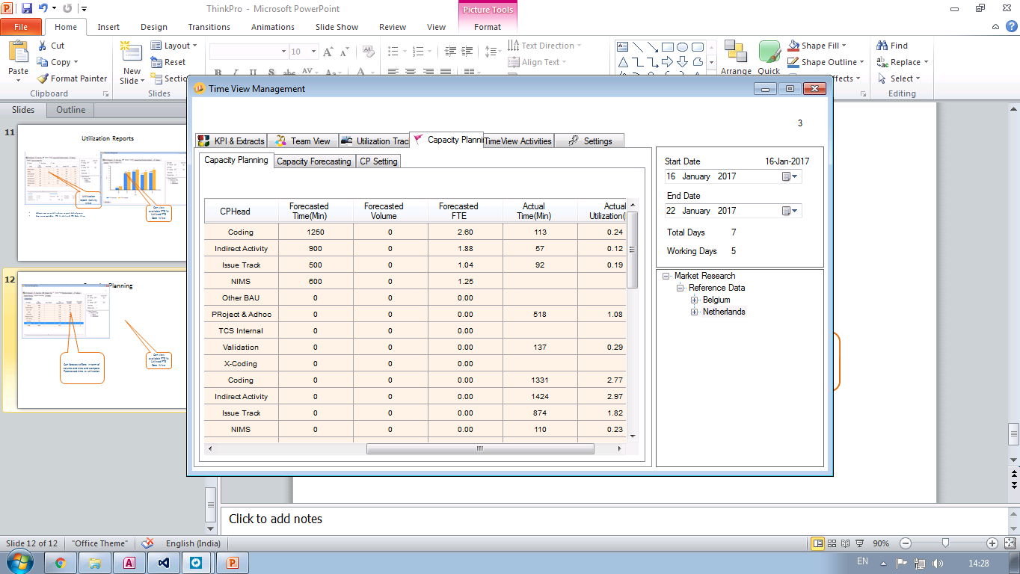
Capacity Planning
Home
Can forecast efforts in term of volume and time and compare Forecasted time vs utilization

Slide 13
Daily, Weekly, Monthly KPI
Home
KPI Example Attached

